Slide 1

The Working Cell
Unit 1; Chapter 5

Slide 2
Biology and Society: Harnessing Cellular Structures
You can think of a cell as a machine that continuously and efficiently performs a variety of functions, such as
movement,
energy processing, and
production of various products.
Notes:
2

Slide 3
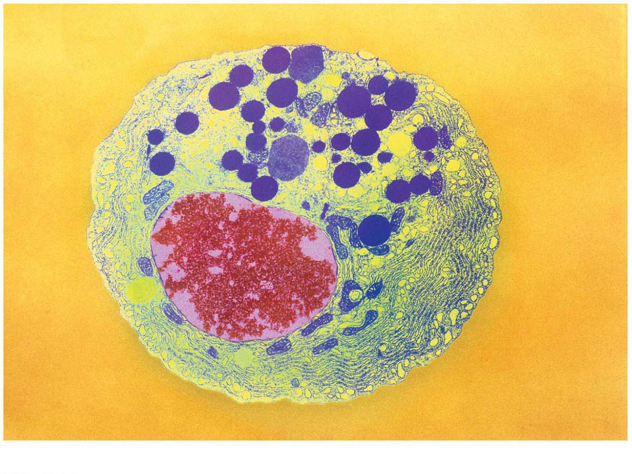
Chapter Thread: Nanotechnology（纳米技术）
Notes:
Figure 5.0-2 Nanotechnology: cellular structures

Slide 4
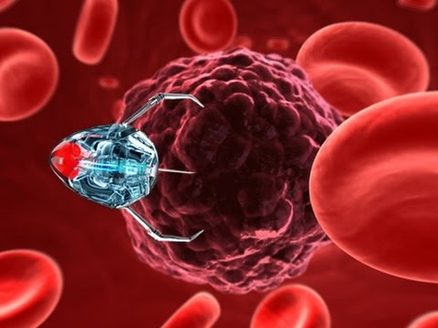
Nanotechnology Cancer Treatment

Slide 5
Biology and Society: Harnessing Cellular Structures
Like other cells, a sperm cell（精子细胞） generates energy by breaking down sugars and other molecules that pass through its plasma membrane（细胞质膜）.
Notes:
5

Slide 6
Biology and Society: Harnessing Cellular Structures
Enzymes within the cell carry out a process called glycolysis（糖酵解）.
During glycolysis, the energy released from the breakdown of glucose is used to produce molecules of ATP.
Within a living sperm, the ATP produced during glycolysis and other processes provides the energy that propels the sperm through the female reproductive tract.
Notes:
6

Slide 7
Biology and Society: Harnessing Cellular Structures
To harness this energy-producing system, researchers attached three glycolysis enzymes to a computer chip.
The enzymes continued to function in this artificial system, producing energy from sugar.
The hope is that a larger set of enzymes can eventually be used to power microscopic robots.
Notes:
7

Slide 8
Biology and Society: Harnessing Cellular Structures
Cells control their chemical environment using
energy,
enzymes, and
the plasma membrane.
Cell-based nanotechnology may be used to power microscopic robots.
Notes:
8

Slide 9
Some Basic Energy Concepts
Energy makes the world go around.
But what is energy?
Notes:
9

Slide 10
Conservation of Energy
Energy is defined as the capacity to cause change.
Some forms of energy are used to perform work, such as moving an object against an opposing force.
Notes:
10

Slide 11
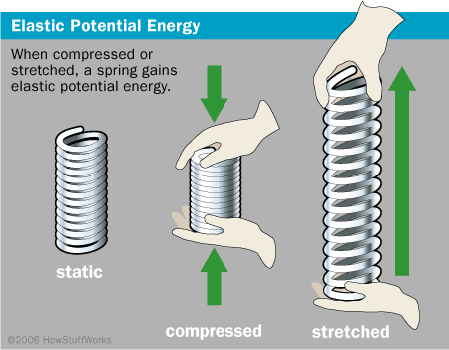
Conservation of Energy
Kinetic energy is the energy of motion.
Potential energy is stored energy, energy that an object has because of its
location or
structure.
Life depends on countless similar conversions of energy from one form to another.
kinet = move (kinetic: type of energy, it is the energy of motion)
Notes:
11

Slide 12
Conservation of Energy
A physical principle (The first law of thermodynamics) known as conservation of energy explains that it is not possible to destroy or create energy.
Energy can only be converted from one form to another.
Notes:
12

Slide 13
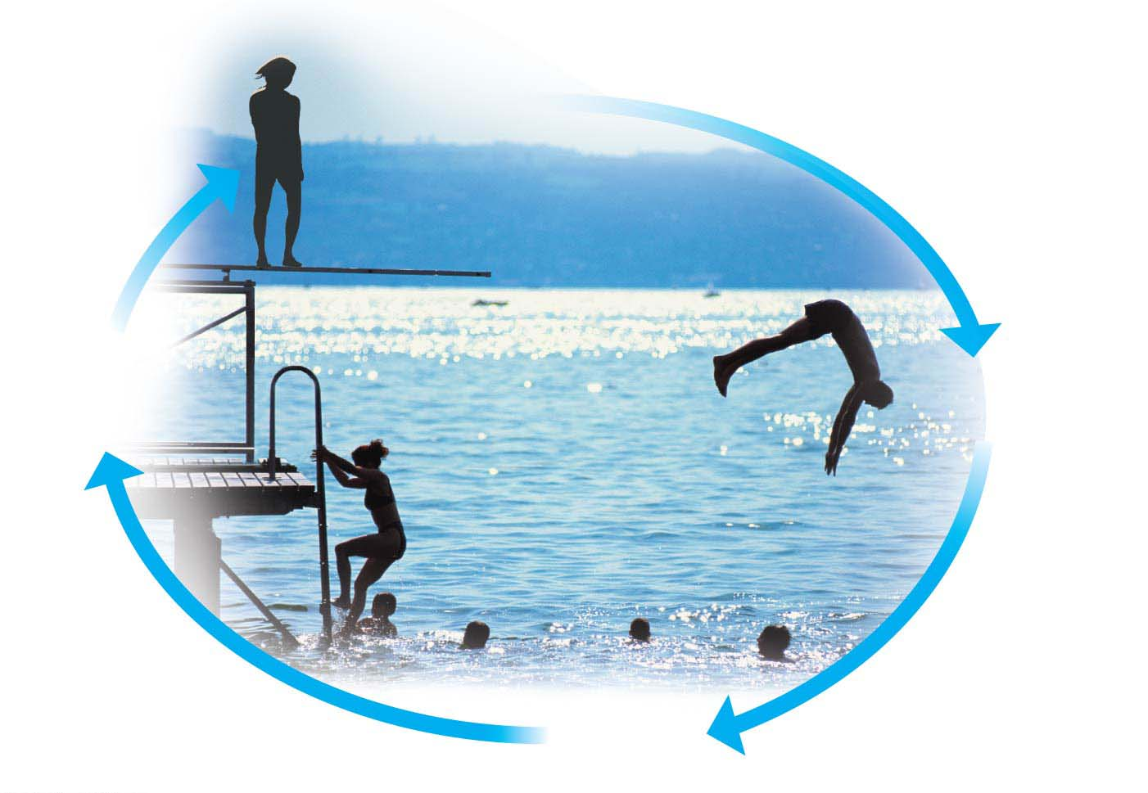
Greatest
potential
energy
Climbing
converts kinetic
energy to
potential energy.
Diving converts
potential
energy to
kinetic energy.
Least
potential
energy

Slide 14
Second Law of Thermodynamics states that the degree of disorder is always increasing in the universe.
Why human body is highly organized when the disorder of
the universe is always increasing?
The answer is a cell takes energy from its environment to
generate order. In turn, the cell releases energy as heat to the environment, giving it what it wants and making it more disordered.

Slide 15
Heat
Heat is a type of kinetic energy contained in the random motion of atoms and molecules (energy in its most disordered, chaotic form).
All energy conversions generate some heat.
Notes:
15

Slide 16
Chemical Energy
The molecules of food, gasoline, and other fuels have a form of potential energy called chemical energy, which arises from the arrangement of atoms and can be released by a chemical reaction.
Living cells and automobile engines use the same basic process to make the chemical energy stored in their fuels available for work.
In both cases, this process breaks organic fuel into smaller waste molecules that have much less chemical energy than the fuel molecules did, thereby releasing energy that can be used to perform work.
Notes:
16

Slide 17
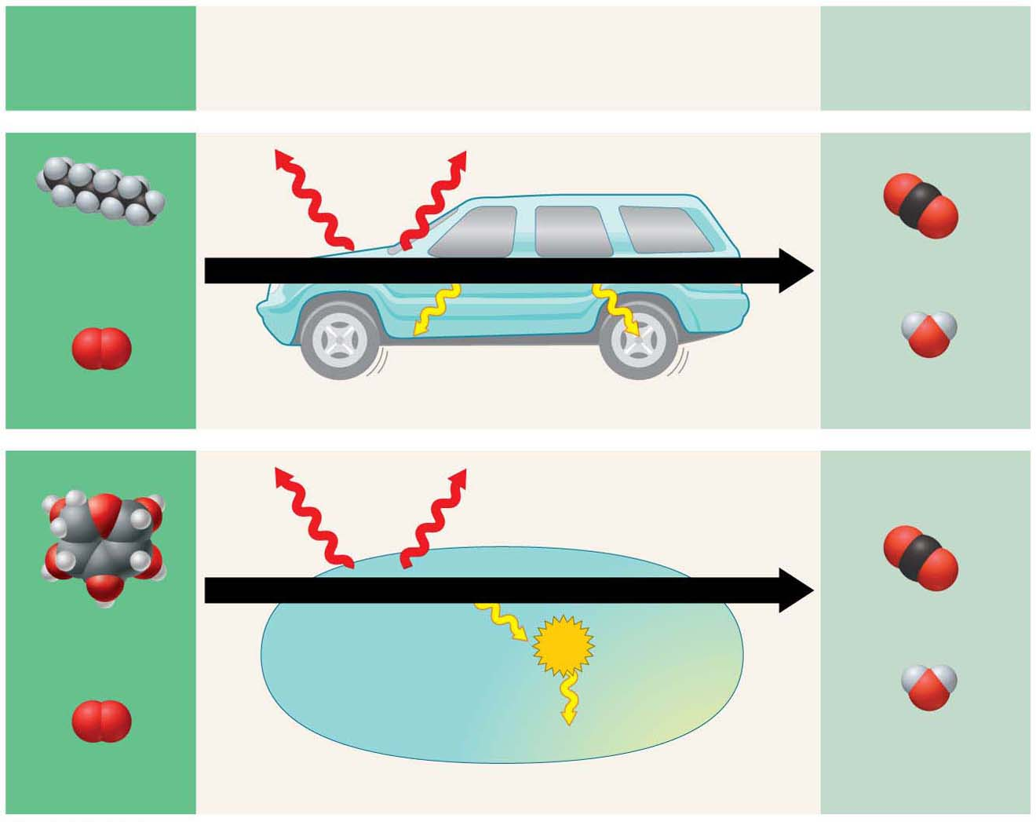
Fuel rich in
chemical
energy
Energy conversion
Waste products
poor in chemical
energy
Heat
energy
Octane
(from gasoline)
Carbon dioxide
Combustion
Kinetic
energy of
movement
+
+
Oxygen
Water
Energy conversion in a car
Heat
energy
Cellular respiration
Glucose（葡萄糖）
(from food)
Carbon dioxide
ATP
+
+
Energy for cellular work
Water
Oxygen
Energy conversion in a cell

Slide 18
Chemical Energy
Cellular respiration（细胞呼吸作用） is
the energy-releasing chemical breakdown of fuel molecules and
the storage of that energy in a form the cell can use to perform work.
Humans convert about 34% (1/3) of our food energy to useful work.
The rest of the energy released by the breakdown of fuel molecules generates body heat.
Notes:
18

Slide 19
Food Calories
A calorie (cal)（卡路里）is the amount of energy that can raise the temperature of 1 gram (g) of water by 1°C.
Food Calories are kilocalories (Cal), equal to 1,000 calories.
The energy of calories in food is used to fuel the activities of life.
Notes:
19

Slide 20
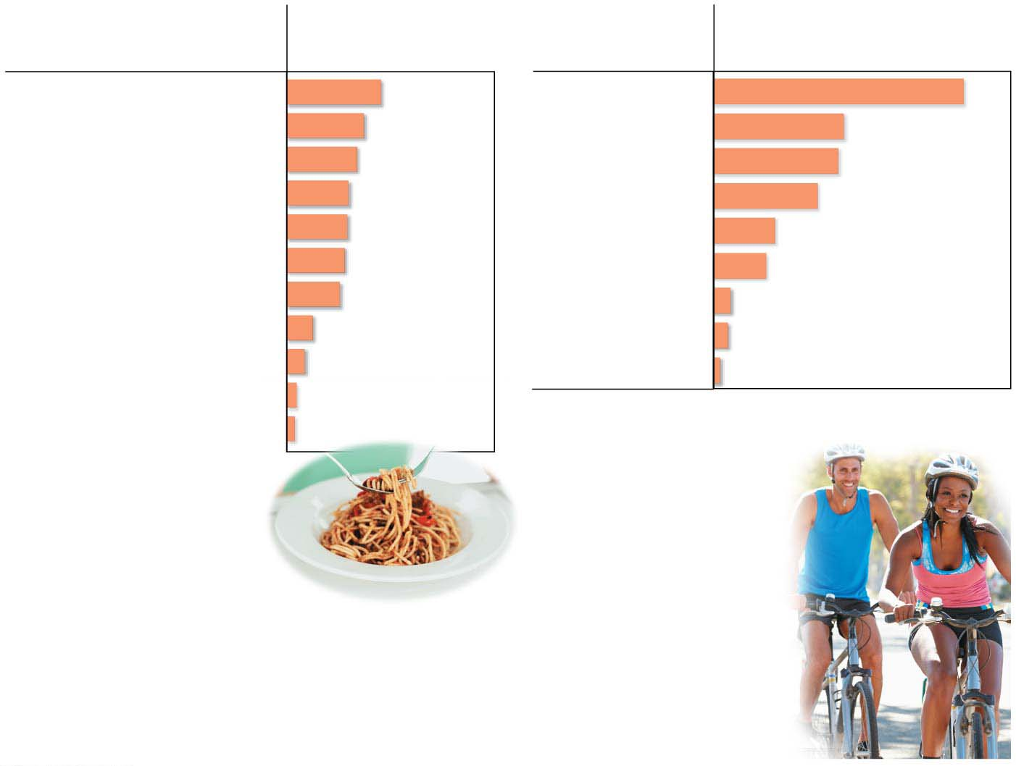
Food
Food Calories
Activity
Food Calories consumed per
hour by a 150-pound person*
Cheeseburger
295
Running (7 min/mi)
979
Spaghetti with sauce (1 cup)
241
Dancing (fast)
510
Baked potato (plain, with skin)
220
Bicycling (10 mph)
490
Fried chicken (drumstick)
193
Swimming (2 mph)
408
Bean burrito
189
Walking (3 mph)
245
Pizza with pepperoni (1 slice)
181
Dancing (slow)
204
Peanuts (1 ounce)
166
Playing the piano
73
Apple
81
Driving a car
61
Garden salad (2 cups)
56
Sitting (writing)
28
Popcorn (plain, 1 cup)
31
*Not including energy necessary for basic functions,
such as breathing and heartbeat
Broccoli (1 cup)
25
(a) Calories
(kilocalories) in
various foods
(b) Calories (k=Kilocalories)
we burn in various activities
min/mi = min/ mile= min/1.7km
mph = miles per hour
Intake > Output : Obesity will develop

Slide 21
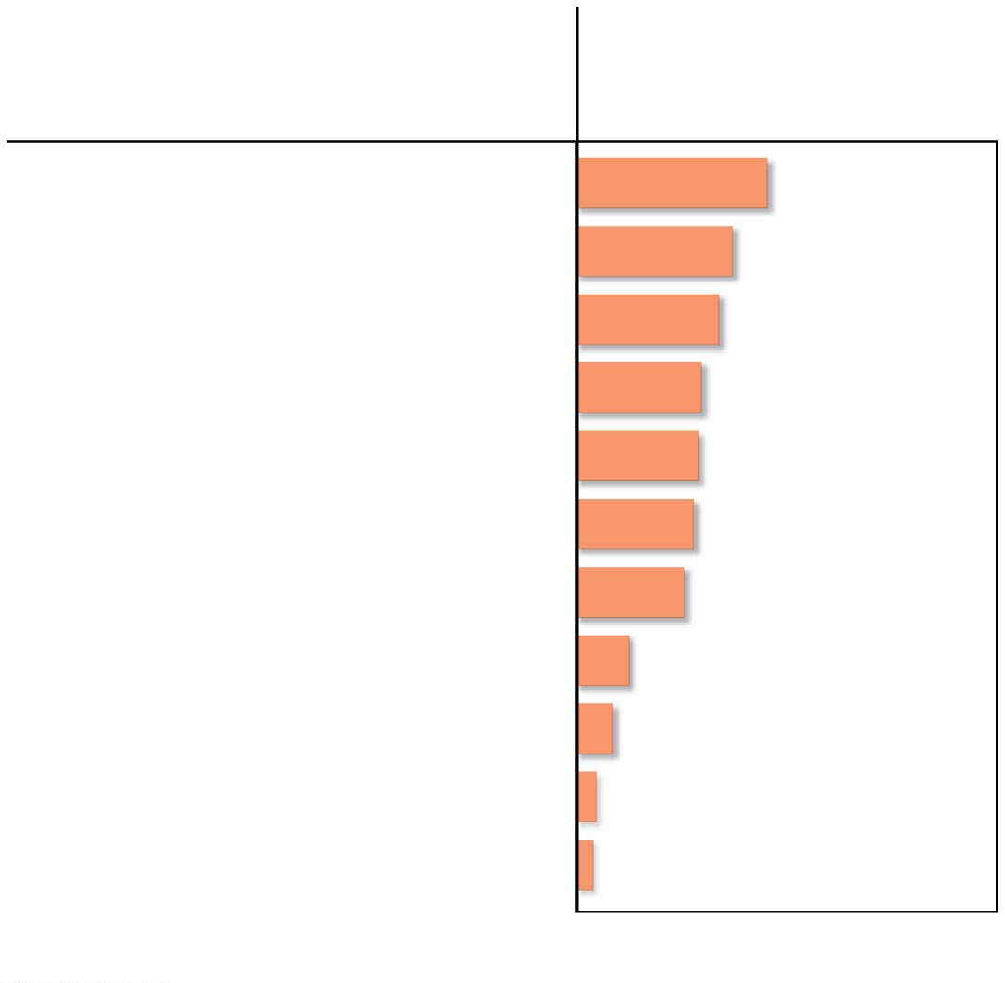
Food
Food Calories
Cheeseburger
295
Spaghetti with sauce (1 cup)
241
Baked potato (plain, with skin)
220
Fried chicken (drumstick)
193
Bean burrito
189
Pizza with pepperoni (1 slice)
181
Peanuts (1 ounce)
166
Apple
81
Garden salad (2 cups)
56
Popcorn (plain, 1 cup)
31
Broccoli (1 cup)
25
Calories (kilocalories) in various foods

Slide 22
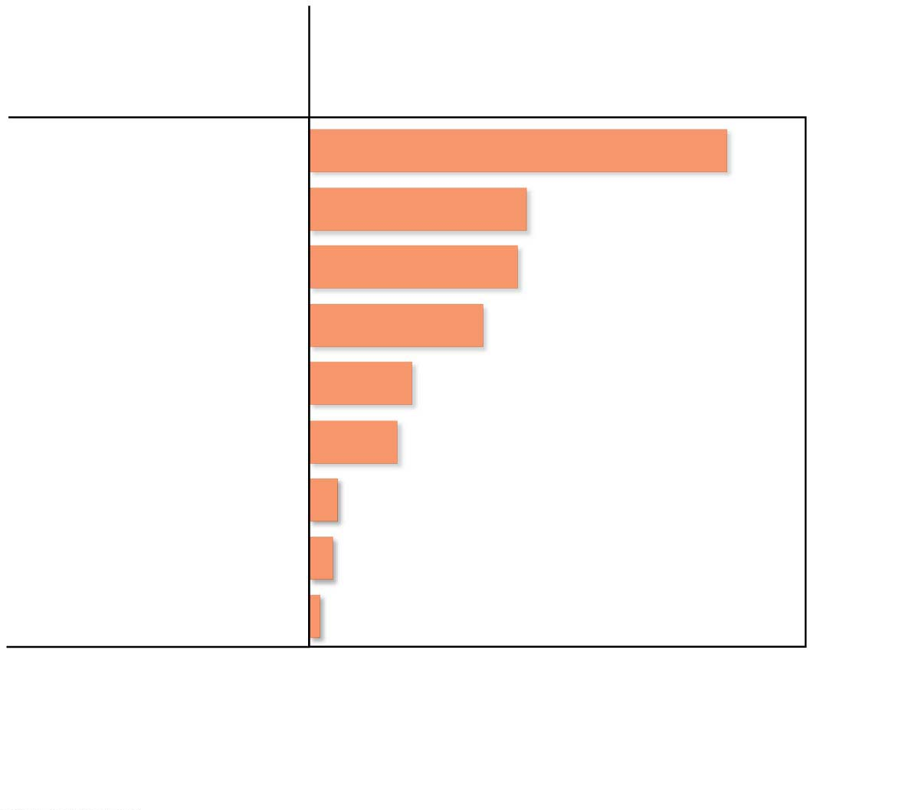
Activity
Food Calories consumed per
hour by a 150-pound person*
Running (7 min/mi)
979
Dancing (fast)
510
Bicycling (10 mph)
490
Swimming (2 mph)
408
Walking (3 mph)
245
Dancing (slow)
204
Playing the piano
73
Driving a car
61
Sitting (writing)
28
*Not including energy necessary for basic functions, such as
breathing and heartbeat
Calories (kilocalories) we burn in various activities
Notes:
Figure 5.3-2 Some caloric accounting (part 2: activities)

Slide 23
Energy Transformations: ATP and Cellular Work
Chemical energy released by the breakdown of organic molecules during cellular respiration is used to generate molecules of ATP（ 三磷酸腺苷（Adenosine Triphosphate））.
Notes:
23

Slide 24
Energy Transformations: ATP and Cellular Work
ATP
acts like an energy shuttle,
stores energy obtained from food, and
releases it later as needed.
Such energy transformations are essential for all life on Earth.
Notes:
24

Slide 25
The Structure of ATP
ATP (adenosine triphosphate)
consists of an organic molecule called adenosine（腺苷） plus a tail of three phosphate groups（磷酸基团） and
is broken down to ADP, adenosine diphosphate（二磷酸腺苷）, and a phosphate group, releasing energy.
The release of the phosphate at the tip of the triphosphate tail makes energy available to cells.
Notes:
25

Slide 26
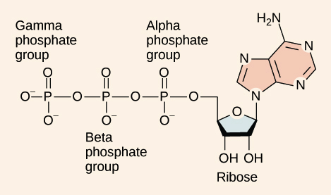
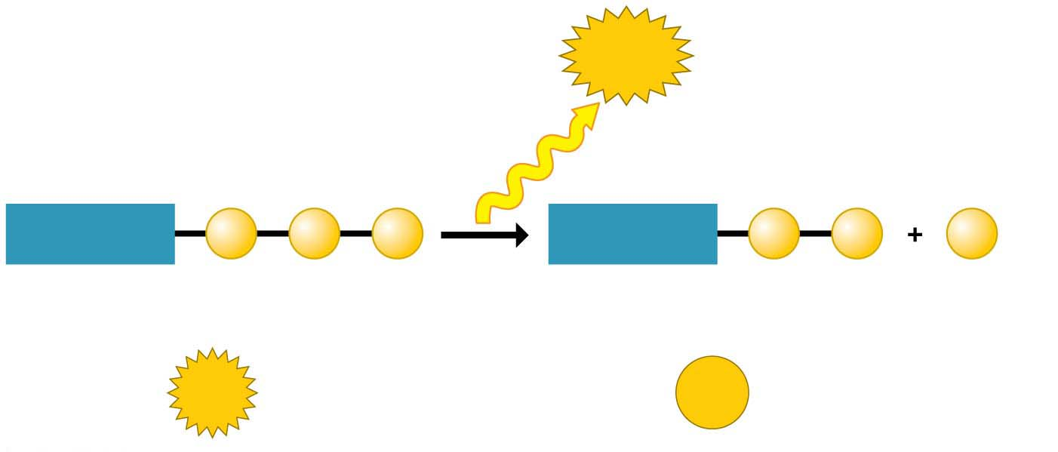
ATP Power
triphosphate
adenosine
Energy
Triphosphate
Diphosphate
Adenosine
P
P
P
Adenosine
P
P
P
Phosphate
(transferred
to another
molecule)
ATP
ADP
Notes:
Figure 5.4 ATP power

Slide 27
Phosphate Transfer
ATP energizes other molecules in cells by transferring phosphate groups to those molecules.
This energy
helps cells change shape,
enables the transport of ions and other dissolved substances across the membranes, and
drives the production of a cell’s large molecules.
Notes:
27

Slide 28
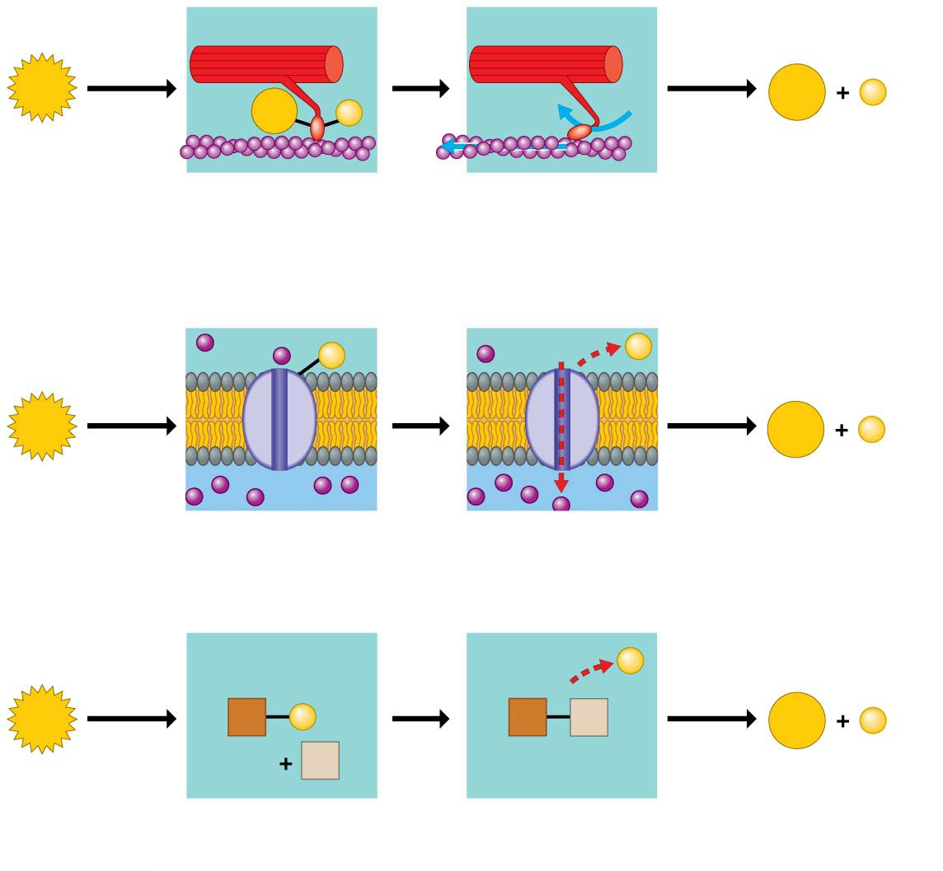
Motor
protein
ATP
ADP
P
ADP
P
Protein moved
(a) Motor protein performing mechanical work (moving a muscle fiber)
Transport
protein
Solute
P
P
ATP
ADP
P
Solute transported
(b) Transport protein performing transport work (importing a solute)
P
ATP
X
P
X
Y
ADP
P
Y
Reactants
Product made
(c) Enzymes performing chemical work (promoting a chemical reaction)
Notes:
Figure 5.5 How ATP drives cellular work

Slide 29
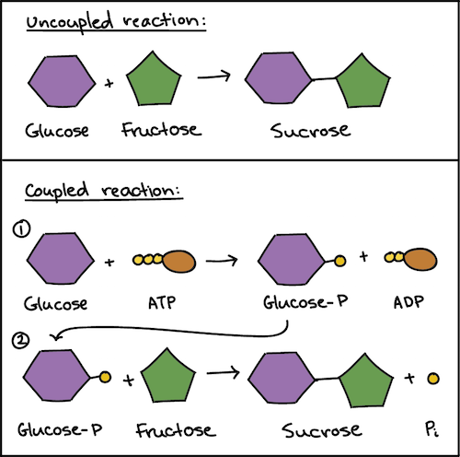
High-energy intermediate

Slide 30
The ATP Cycle
Cells spend ATP continuously.
Cellular work spends ATP, which is recycled when ADP and phosphate are combined, using energy released by cellular respiration.
Up to 10 million ATPs are consumed and recycled each second in a working muscle cell.
Notes:
30

Slide 31
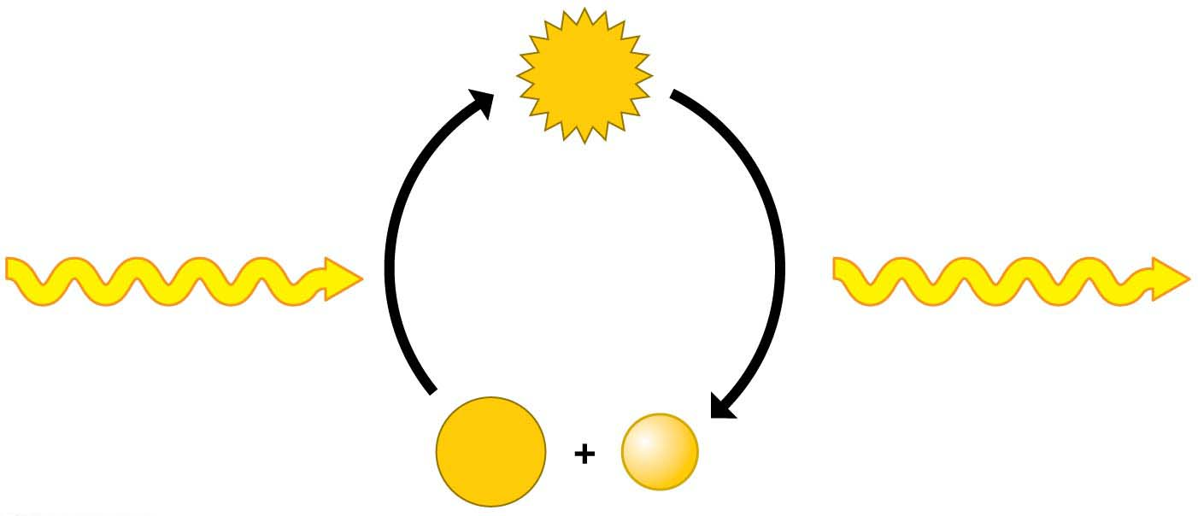
ATP
Cellular respiration:
chemical energy
harvested from
fuel molecules
Energy for
cellular work
ADP
P
Notes:
Figure 5.6 The ATP cycle

Slide 32
Enzymes
Metabolism（新陈代谢） is the total of all chemical reactions in an organism.
Most metabolic reactions require the assistance of enzymes, proteins that speed up chemical reactions without being consumed by the reaction.
All living cells contain thousands of different enzymes, each promoting a different chemical reaction.
Notes:
32

Slide 33
Activation Energy
Activation energy is the energy that must be invested to start a reaction, by
activating the reactants and
triggering a chemical reaction.
Enzymes enable metabolism to occur by reducing the amount of activation energy required to break the bonds of reactant molecules.
Notes:
33

Slide 34
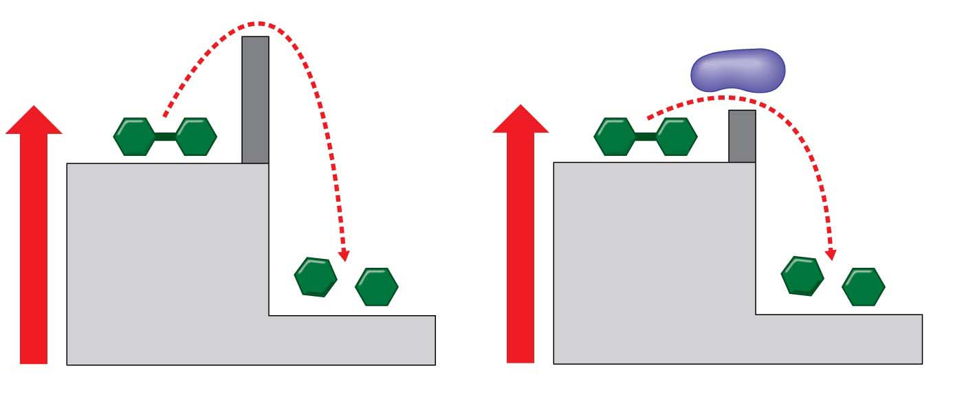
Transition State
Activation
energy barrier
without enzyme
Activation
energy barrier
reduced by
enzyme
Enzyme
Reactant
Reactant
Energy
Energy
Products
Products
(a) Without enzyme
(b) With enzyme
Notes:
Figure 5.7 Enzymes and activation energy

Slide 35
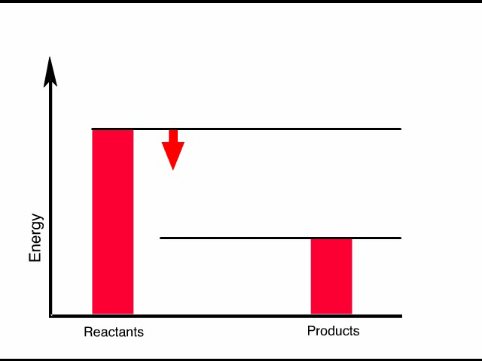
Animation: How Enzymes Work
An exergonic reaction refers to a reaction where energy is released.

Slide 36
Endergonic reactions require an input of energy to occur.

Slide 37
The Process of Science: Can Enzymes Be Engineered?
Observation: Genetic sequences suggest that many of our genes were formed through a type of molecular evolution.
Question: Can laboratory methods mimic this process through artificial selection?
Hypothesis: An artificial process could be used to modify the gene that codes for lactase（乳糖分解酶） into a new gene coding for an enzyme with a new function.
Notes:
37

Slide 38
The Process of Science: Can Enzymes Be Engineered?
Experiment: Using the process of directed evolution, many copies of the lactase gene were randomly mutated（突变） and tested for new activities.
Results: Directed evolution produced a new enzyme with a novel function.
Notes:
38

Slide 39
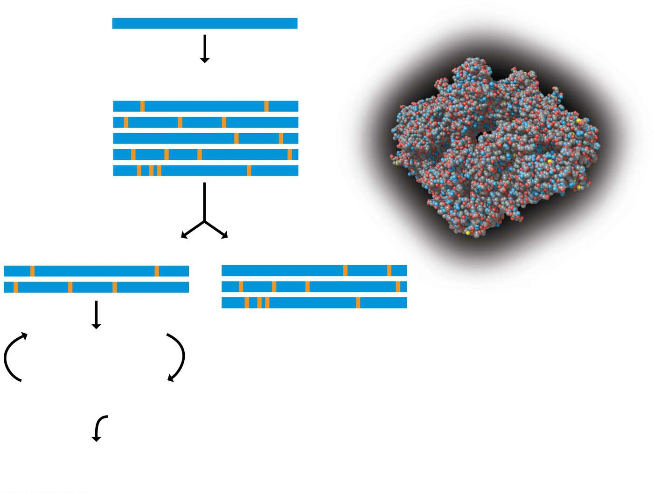
Gene for lactase
Gene duplicated and
mutated at random
Mutated genes
(mutations shown in orange)
Mutated genes screened
by testing new enzymes
Genes coding for enzymes
that show new activity
Genes coding for enzymes
that do not show new activity
Computer-generated model
of the enzyme lactase
Genes duplicated
and mutated at random
Mutated genes screened
by testing new enzymes
After seven rounds, some genes
code for enzymes that can
efficiently perform new activity.

Slide 40
Structure/Function: Enzyme Activity
An enzyme is very selective in the reaction it catalyzes.
Each enzyme recognizes a substrate, a certain reactant molecule.
The active site has a shape and chemistry that fits the substrate molecule.
This interaction is called induced fit（诱导配合） because the entry of the substrate induces the enzyme to change shape slightly, making the fit between the substrate and active site snugger.
Notes:
40

Slide 41
Structure/Function: Enzyme Activity
After the products are released from the active site, the enzyme can accept another molecule of its substrate.
The ability to function repeatedly is a key characteristic of enzymes.
Many enzymes are named for their substrates, but with an –ase ending.
Notes:
41

Slide 42
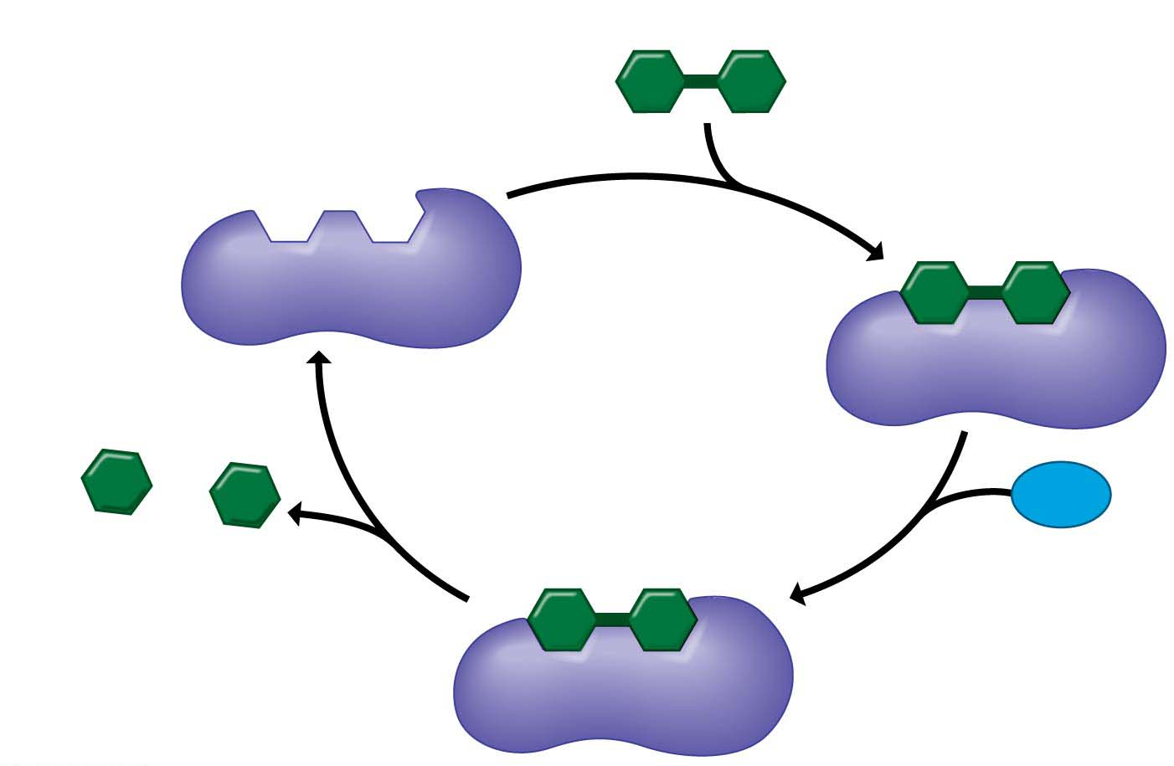
1
Ready for
substrate
Substrate (lactose乳糖)
Active site
2
Substrate
binding
Enzyme
(lactase)
Galactose（半乳糖）
H₂O
Glucose（葡萄糖）
4
Product
release
3
Catalysis
Notes:
Figure 5.9-s4 How an enzyme works (step 4)

Slide 43
Enzyme Inhibitors
Certain molecules inhibit a metabolic reaction by
binding to an enzyme and
disrupting its function.
Some of these enzyme inhibitors（酶抑制剂） are actually substrate imposters that plug up the active site.
Notes:
43

Slide 44
Enzyme Inhibitors
Other inhibitors bind to the enzyme at a site remote from the active site, but the binding changes the enzyme’s shape so that the active site no longer accepts the substrate.
In each case, an inhibitor disrupts the function of an enzyme by altering its shape.
Notes:
44

Slide 45
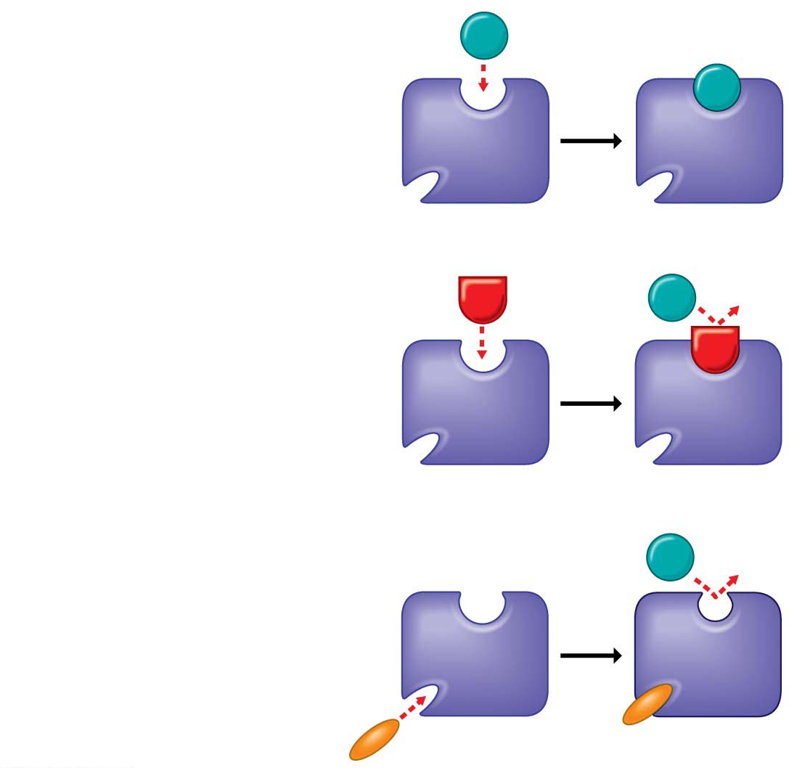
(a) Enzyme and substrate
binding normally
Substrate
Active site
Enzyme
(b) Enzyme inhibition by
a substrate imposter
Inhibitor
Substrate
Active site
Competitive Inhibitor
Enzyme
(c) Inhibition of an enzyme
by a molecule that causes
the active site to change
shape
Substrate
Active site
Non-competitive
Inhibitor
Inhibitor
Enzyme
Notes:
Figure 5.10 Enzyme inhibitors

Slide 46
Enzyme Inhibitors
In some cases, the binding of an inhibitor is reversible.
If a cell is producing more of a certain product than it needs, that product may reversibly inhibit an enzyme required for its production, keeping the cell from wasting resources that could be put to better use. (Feedback inhibition)
Notes:
46

Slide 47
Enzyme Inhibitors
Many beneficial drugs work by inhibiting enzymes.
Penicillin（青霉素） blocks the active site of an enzyme that bacteria use in making cell walls.
Ibuprofen（布洛芬（消炎镇痛药）） inhibits an enzyme involved in sending pain signals.
Many cancer drugs inhibit enzymes that promote cell division.
Many toxins（毒素） and poisons（毒药） also work as inhibitors.
Notes:
47

Slide 48
Membrane Function
Of all the major functions of these membrane proteins, one of the most important is the regulation of transport in and out of the cell.
Notes:
48

Slide 49
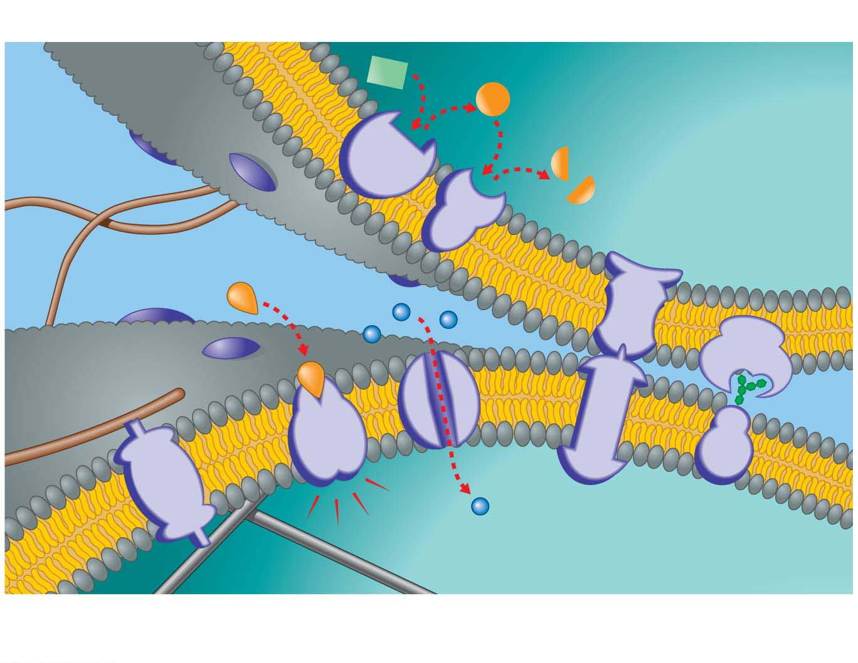
Cell signaling
Enzymatic activity
Cytoplasm
（细胞质）
Fibers of
extracellular
（细胞外的）matrix
Cytoplasm
Cytoskeleton（细胞骨架）
Attachment to the cytoskeleton
and extracellular matrix
Transport
Intercellular
（细胞间的）
joining
Cell-cell
recognition
Notes:
Figure 5.11 Primary functions of membrane proteins

Slide 50
Passive Transport: Diffusion across Membranes
Molecules constantly vibrate and wander randomly.
Diffusion is the movement of molecules spreading out evenly into the available space.
Imagine a membrane separating pure water from a mixture of dye dissolved in water.
Notes:
50

Slide 51
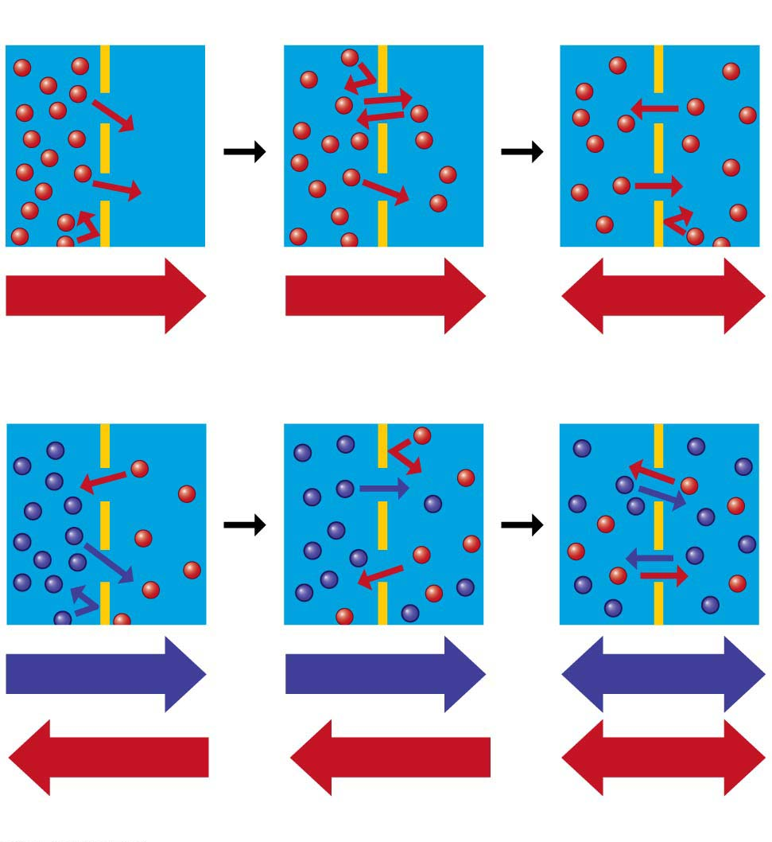
Molecules of dye
Membrane
Net diffusion
Net diffusion
Equilibrium
(a) Passive transport of one type of molecule
Net diffusion
Net diffusion
Equilibrium
Net diffusion
Net diffusion
Equilibrium
(b) Passive transport of two types of molecules
Notes:
Figure 5.12 Passive transport: diffusion across a membrane

Slide 52
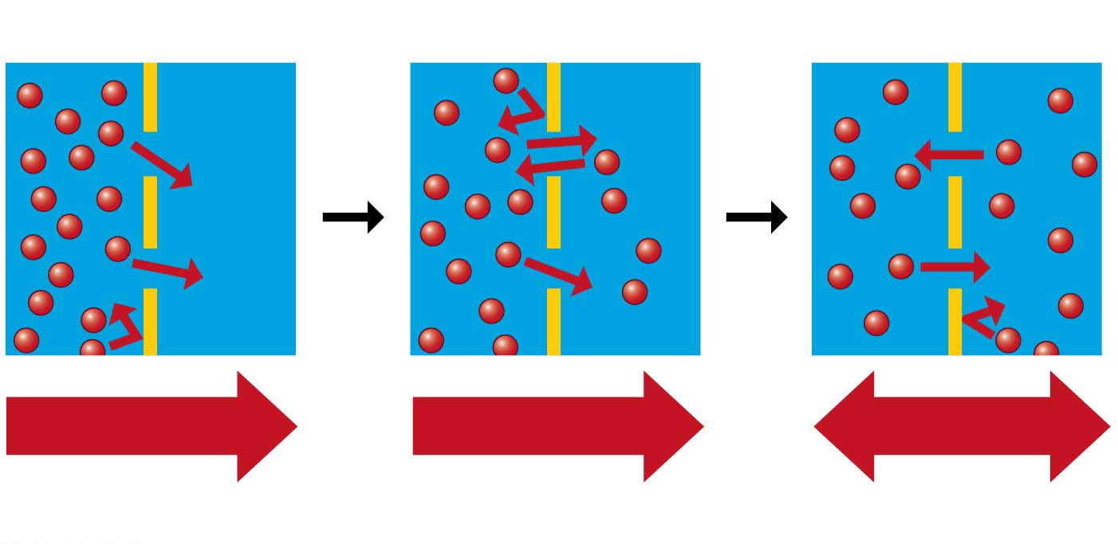
Molecules of dye
Membrane
Net diffusion
Net diffusion
Equilibrium
(a) Passive transport of one type of molecule
Notes:
Figure 5.12-1 Passive transport: diffusion across a membrane (part 1: one type of molecule)

Slide 53
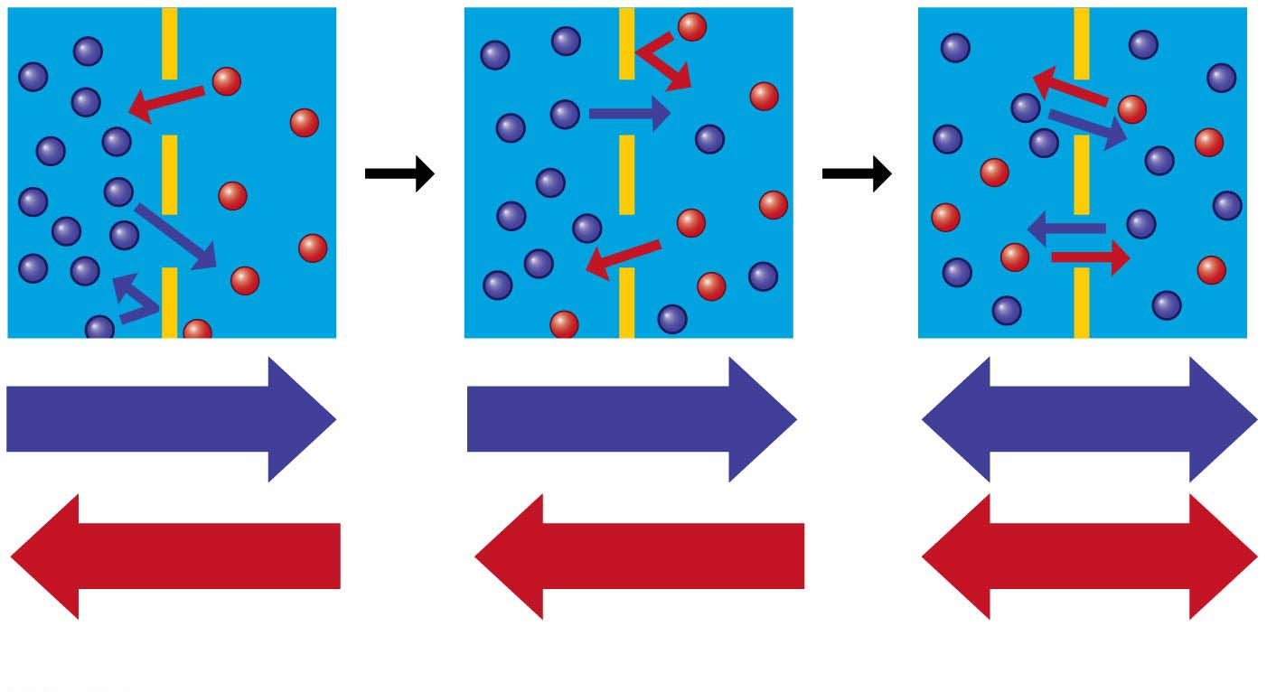
Net diffusion
Net diffusion
Equilibrium
Net diffusion
Net diffusion
Equilibrium
(b) Passive transport of two types of molecules
Notes:
Figure 5.12-2 Passive transport: diffusion across a membrane (part 2: two types of molecules)

Slide 54
Passive Transport: Diffusion across Membranes
Passive transport is the diffusion of a substance across a membrane without the input of energy.
In passive transport, a substance diffuses down its concentration gradient from where the substance is more concentrated to where it is less concentrated.

Slide 55
Passive Transport: Diffusion across Membranes
Substances that do not cross membranes spontaneously, or otherwise cross very slowly, can be transported via proteins that act as corridors for specific molecules.
This assisted transport is called facilitated diffusion, a type of passive transport because it does not require the cell to expend energy.
Notes:
55

Slide 56
Osmosis and Water Balance
The diffusion of water across a selectively permeable membrane（渗透膜） is osmosis（渗透作用）.
A solute is a substance that is dissolved in a liquid solvent, such as the salt in salt water, and the resulting mixture is called a solution.
Notes:
56

Slide 57
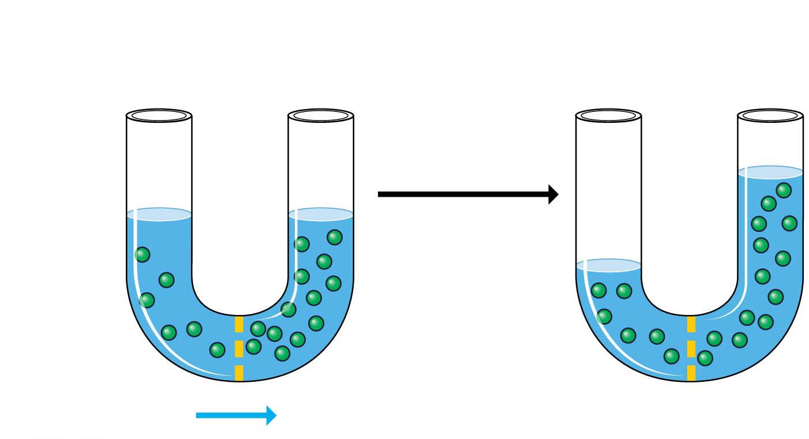
Lower
concentration
(hypotonic)（低渗的）
Higher
concentration
(hypertonic)（高渗的）
Equal concentrations
(isotonic)（等渗的）
Osmosis
(net movement
of water)
Sugar
molecule
(solute)
Selectively
permeable
membrane

Slide 58
Osmosis and Water Balance
Compared to another solution,
a hypertonic solution has a higher concentration of solute,
a hypotonic solution has a lower concentration of solute, and
an isotonic solution has an equal concentration of solute.
Notes:
58

Slide 59
Water Balance in Animal Cells
The survival of a cell depends on its ability to balance water uptake and loss.
For an animal to survive a hypotonic or hypertonic environment, the animal must have a way to balance the uptake and loss of water.
The control of water balance is called osmoregulation（渗透调节）.
Notes:
59

Slide 60
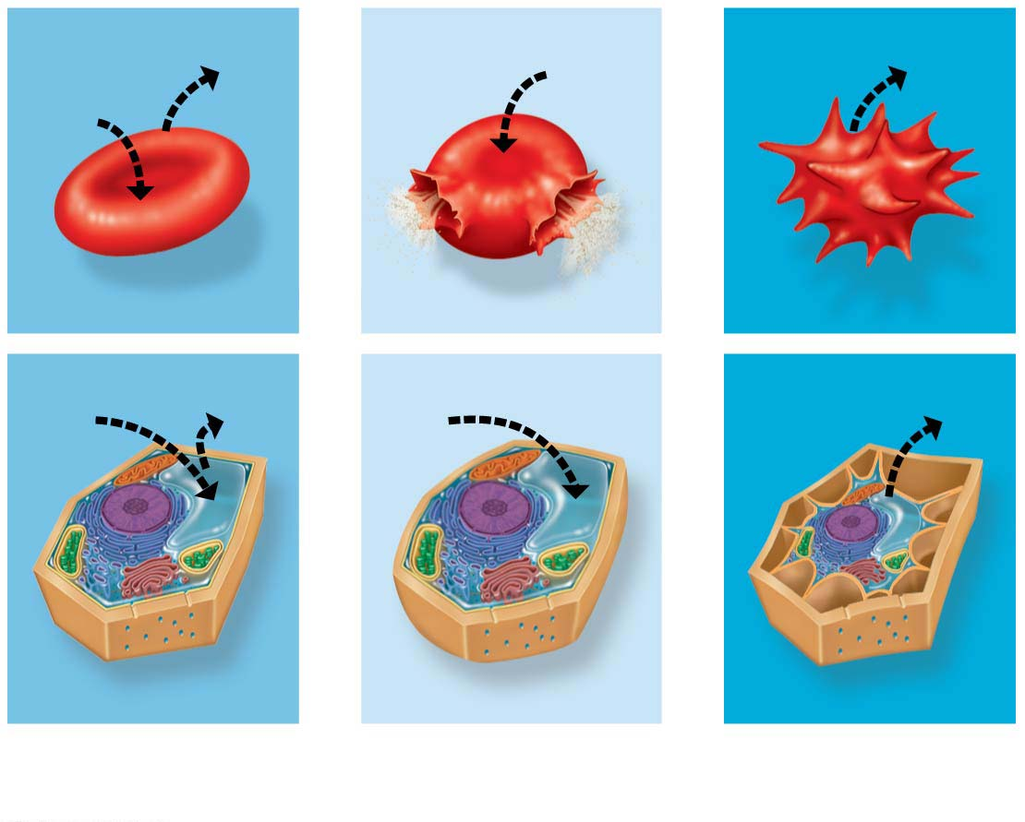
Animal cell
H₂O
H₂O
H₂O
H₂O
Normal
Lysing（细胞溶解）
Shriveled
Plant cell
Plasma
membrane
H₂O
H₂O
H₂O
H₂O
Flaccid（松弛的） (wilts)
Turgid（肿胀的） (normal)
Shriveled
(a) Isotonic
solution
(b) Hypotonic
solution
(c) Hypertonic
solution
Notes:
Figure 5.14 Osmotic environments

Slide 61
Water Balance in Plant Cells
Plant cells have rigid cell walls.
Plant cells are healthiest in a hypotonic environment with a net inflow of water, which expands their cell walls without bursting.
Notes:
61

Slide 62
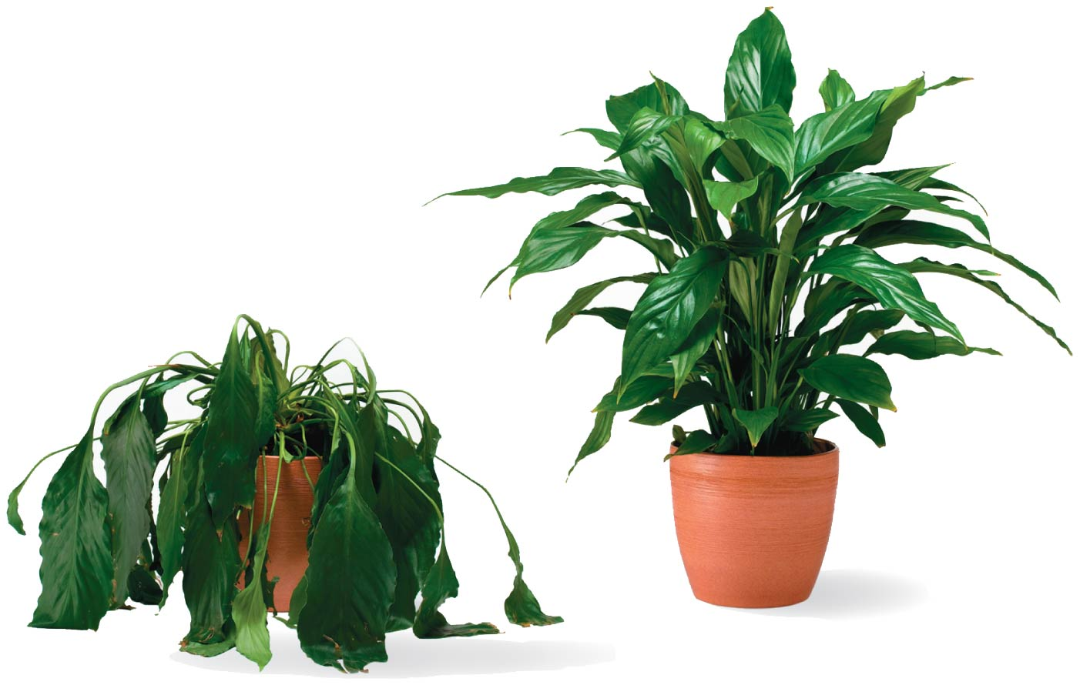
Notes:
Figure 5.15 Plant turgor

Slide 63
Water Balance in Plant Cells
As a plant cell loses water,
it shrivels and
its plasma membrane may pull away from the cell wall, which usually kills the cell.
Notes:
63

Slide 64
Active Transport: The Pumping of Molecules across Membranes
Active transport requires that a cell expend energy to move molecules across a membrane.
Cellular energy (usually provided by ATP) is used to drive a transport protein that pumps a solute against the concentration gradient.
Active transport allows cells to maintain internal concentrations of small solutes that differ from environmental concentrations.
Notes:
64

Slide 65
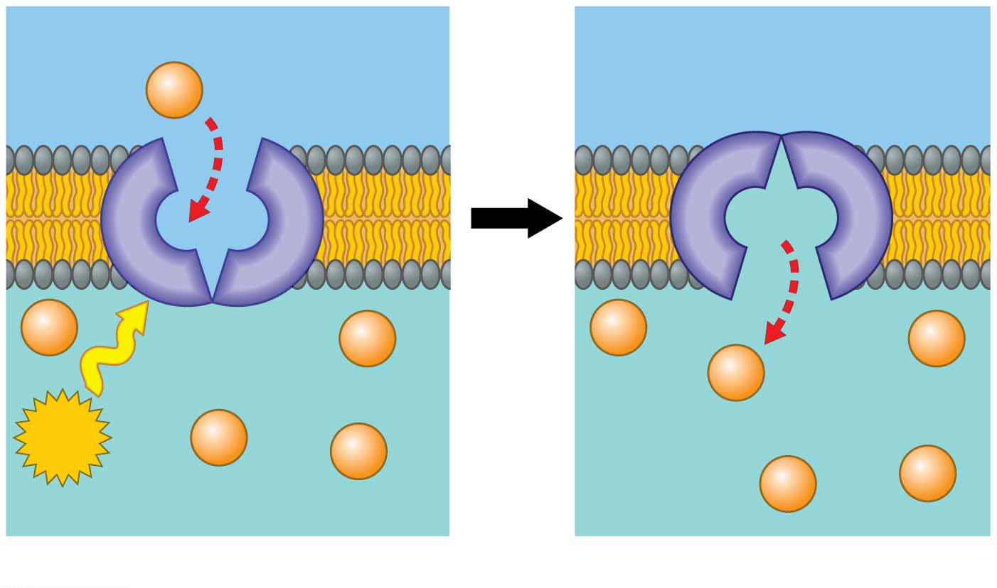
Figure 5.16-s2
Lower solute concentration
Solute
ATP
Higher solute concentration
Active transport
Notes:
Figure 5.16-s2 Active transport (step 2)

Slide 66
Exocytosis and Endocytosis: Traffic of Large Molecules
Exocytosis（胞吐作用） is the movement of materials out of the cytoplasm of a cell via membranous vesicles（囊泡） or vacuoles（液泡） that fuse with the plasma membrane（细胞质膜）.
exo = outside, cyto = cell (exocytosis: eliminating some materials outside of the cells)
Notes:
66

Slide 67
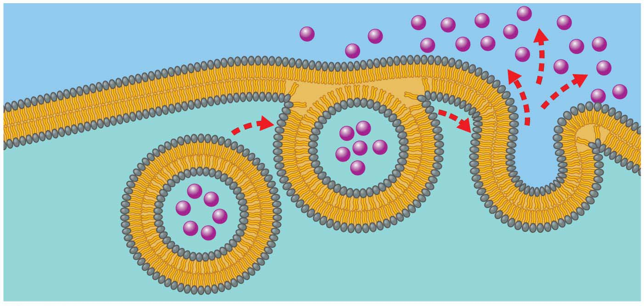
Outside of cell
Plasma
membrane
Molecule to be exported
Cytoplasm（细胞质）
Notes:
Figure 5.17 Exocytosis

Slide 68
Exocytosis and Endocytosis（胞吞）: Traffic of Large Molecules
In endocytosis, a cell takes material in via vesicles（囊泡） that bud inward.
For example, in a process called phagocytosis（吞噬作用） (“cellular eating”), a cell engulfs（吞噬） a particle and packages it within a food vacuole（食物泡）.
endo = inner, cyto = cell (endocytosis: taking material into the cells)
phago = eat (phagocytosis: cellular eating)
Notes:
68

Slide 69
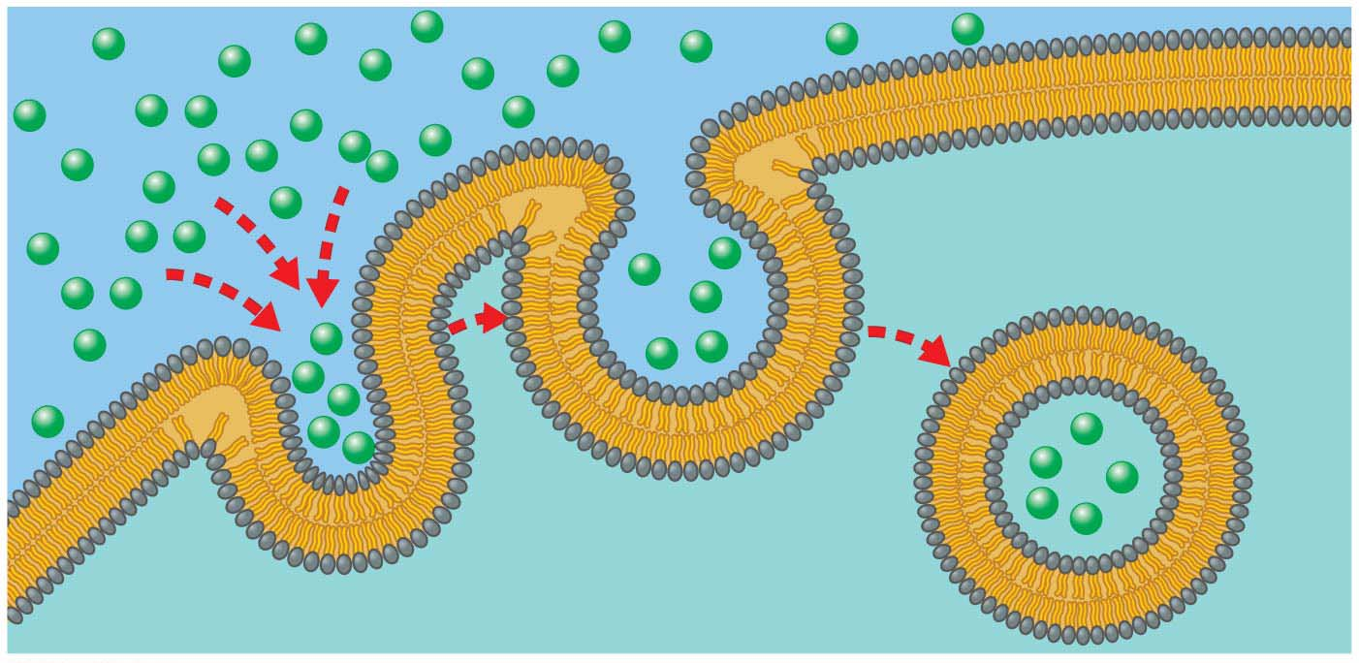
Notes:
Figure 5.18 Endocytosis

Slide 70
Evolution Connection: The Origin of Membranes
Phospholipids（磷脂）
are key ingredients of membranes,
were probably among the first organic compounds that formed from chemical reactions on early Earth, and
self-assemble into simple membranes.
Notes:
70

Slide 71
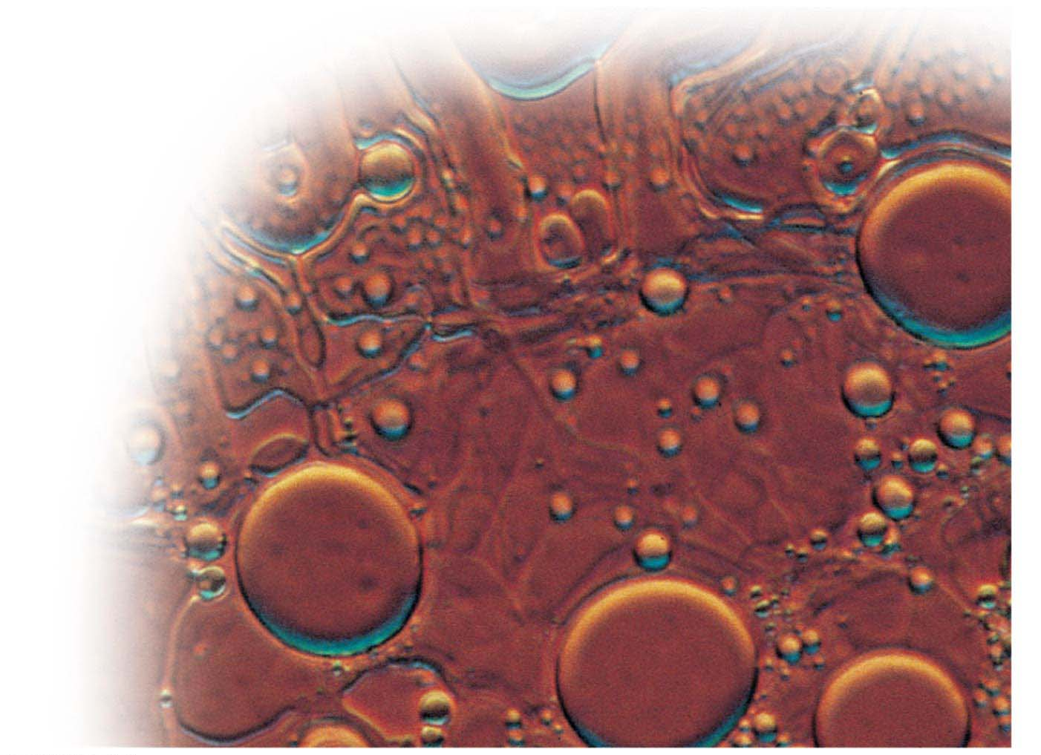
The spontaneous formation of membranes: a key step in the origin of life
Water-filled
bubble made of
phospholipids
Colorized LM
Notes:
Figure 5.19 The spontaneous formation of membranes: a key step in the origin of life

Slide 72
Evolution Connection: The Origin of Membranes
The tendency of lipids in water to spontaneously form membranes has led biomedical engineers to produce liposomes（脂质体） (a type of artificial vesicle) that can encase particular chemicals.
These engineered liposomes may be used to deliver nutrients or medications to specific sites within the body.
Notes:
72

Slide 73
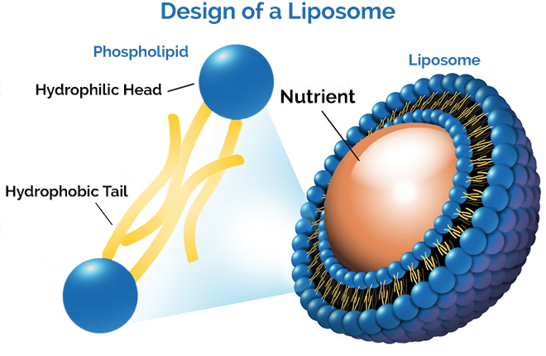

Slide 74
Evolution Connection: The Origin of Membranes
The formation of membrane-enclosed collections of molecules would have been a critical step in the evolution of the first cells.
A membrane can enclose a solution that is different in composition from its surroundings.
A plasma membrane that allows cells to regulate their chemical exchanges with the environment is a basic requirement for life.
Indeed, all cells are enclosed by a plasma membrane that is similar in structure and function—illustrating the evolutionary unity of life.
Notes:
74

Slide 75
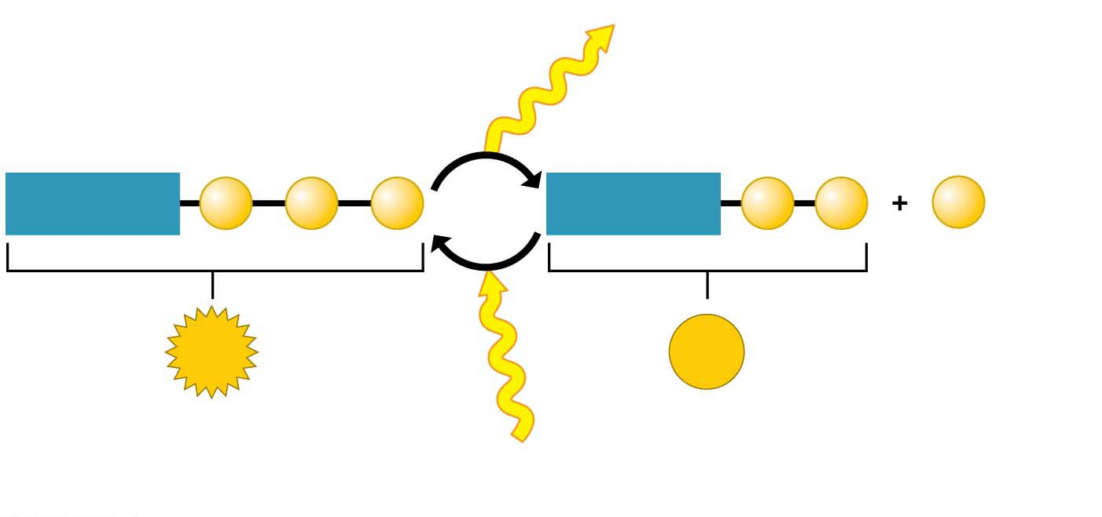
Energy for cellular work
Adenosine
P
P
P
ATP
cycle
Adenosine
P
P
P
Phosphate
(can be transferred
to another molecule)
ATP
ADP
Adenosine
triphosphate
Adenosine
diphosphate
Energy from
organic fuel

Slide 76
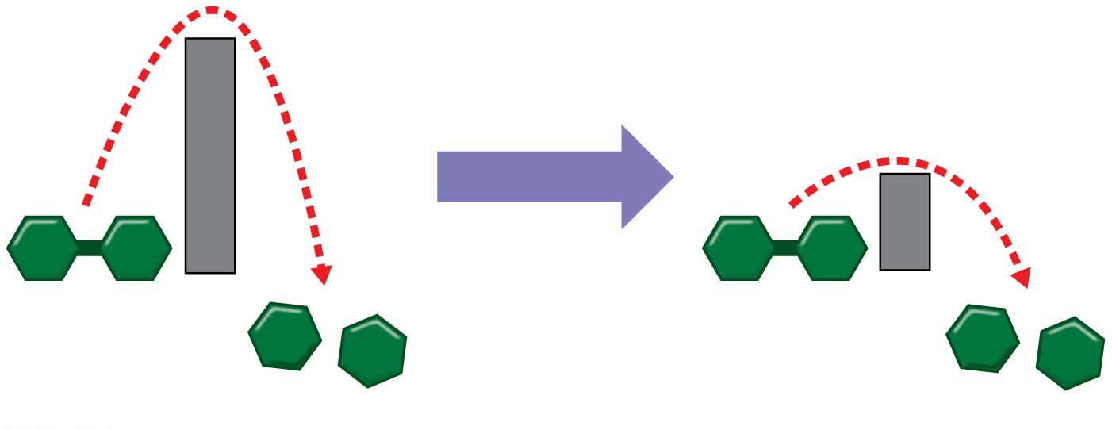
Activation energy
Enzyme added
Reactant
Reactant
Products
Products

Slide 77
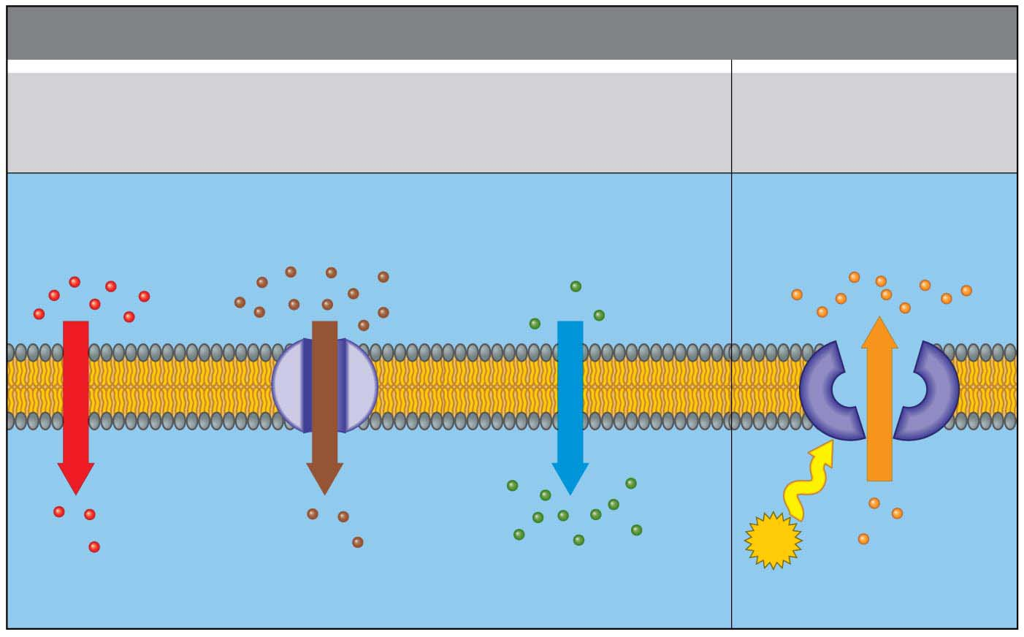
MEMBRANE TRANSPORT
Passive Transport
(requires no energy)
Active Transport
(requires energy)
Diffusion
Facilitated diffusion
Osmosis
Higher solute concentration
Higher water concentration
(lower solute concentration)
Higher solute
concentration
Solute
Solute
Solute
Water
Solute
ATP
Lower solute concentration
Lower water concentration
(higher solute concentration)
Lower solute
concentration

Slide 78
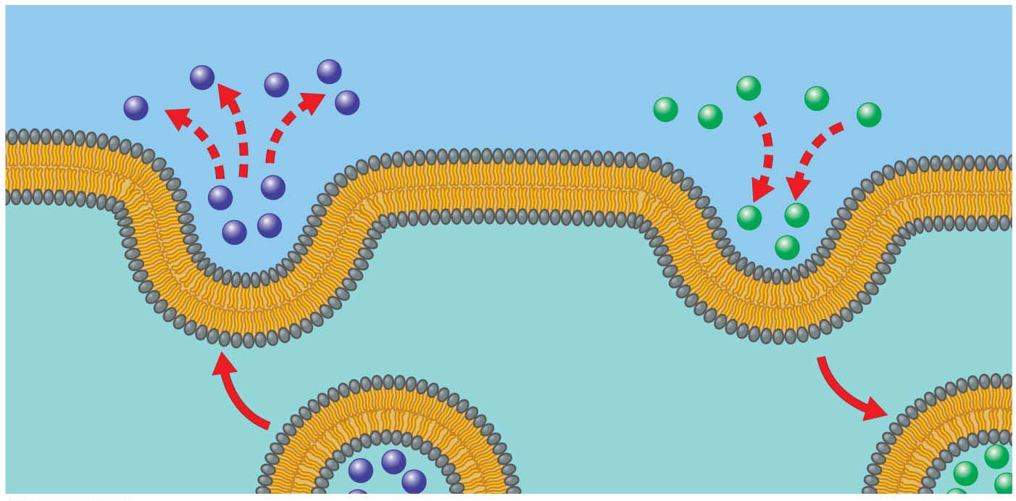
Exocytosis
Endocytosis

Slide 79
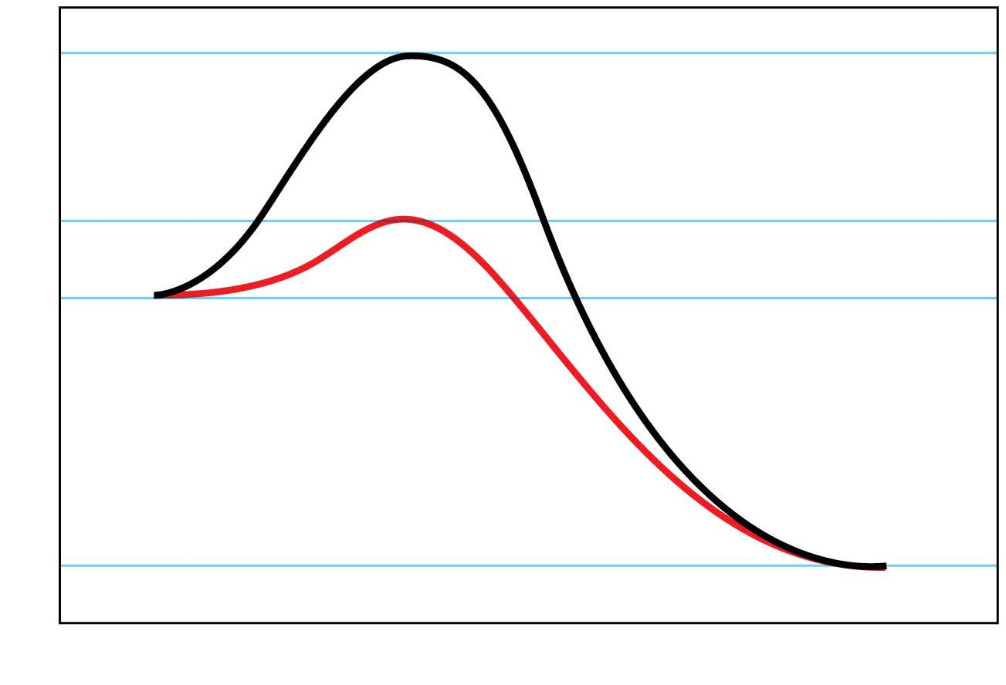
a
b
Energy
Reactants
c
Products
Progress of the reaction

